Slide 1
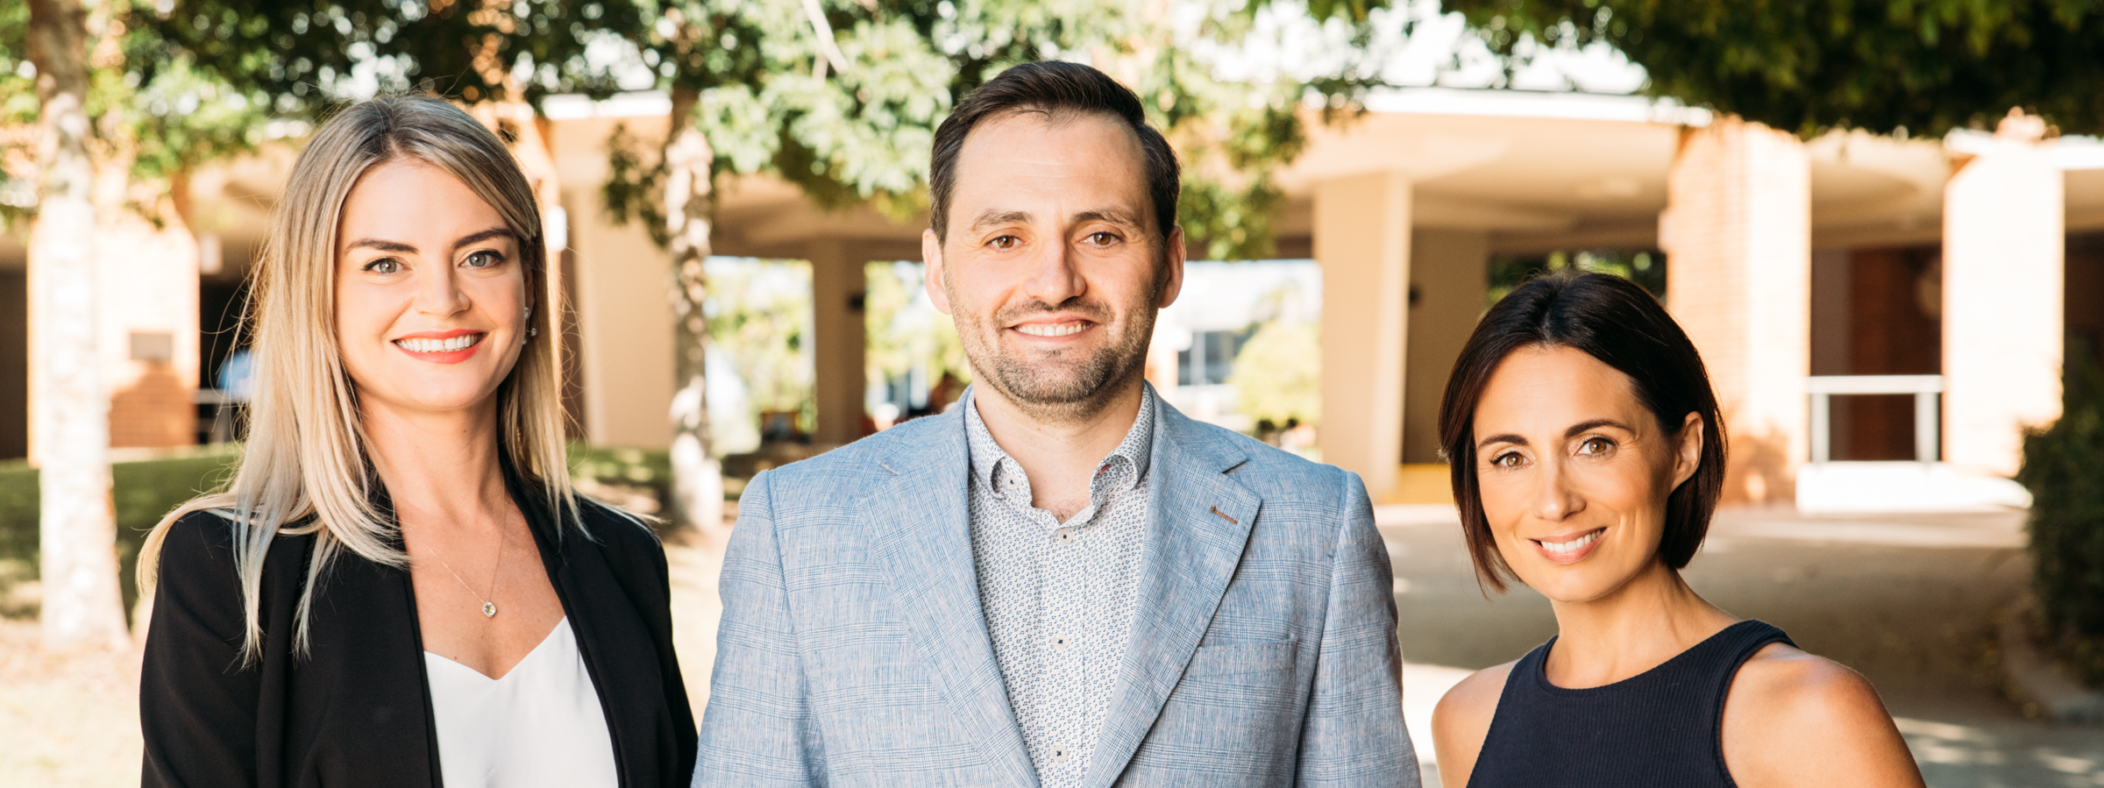

R-LADIES: Shiny APPs FOR PLACE BASED INITIATIVES
@rhetta_chappell

Slide 2
WHY
WHAT
Meaningful data changes lives, but in many communities it is not easily accessed or understood…
HOW
WHY
Notes:
To unlock the power of data to empower and accelerate the development of flourishing communities

Slide 3
WHY
WHAT
Meaningful data changes lives, but in many communities it is not easily accessed or understood…
HOW
HOW
WHY
So we’ll work with partners to combine the knowledge, independence and capacity for powerful analytics that sit with universities, with the knowledge, energy and lived experience of people in communities, to unlock the value in data…
Notes:
So how do we plan to help unlock the power of data and make it accessible? The answer is through strong and strategic partnerships and collaborations, with
the wealth of intelligence that sits within Griffith university
all levels of government
not-for-profit
private sectors
Community
These partnerships allow us to be at the forefront of regional innovation through data, leveraging our respective strengths to be a national and international leader in harnessing data to build innovative, dynamic, regions of the future.

Slide 4
WHY
WHAT
Meaningful data changes lives, but in many communities it is not easily accessed or understood…
HOW
HOW
WHY
So we’ll work with partners to combine the knowledge, independence and capacity for powerful analytics that sit with universities, with the knowledge, energy and lived experience of people in communities, to unlock the value in data…
WHAT
For collaborations and outputs that increase capacity and capability at a community level and lead to better place-based decision making across all stakeholder groups.
Notes:
So this is all well and good, but what do we actually build, what is the end result? In all honesty it depends on the project as our approaches are very much tailored to suit our clients, but this doesn’t mean we are constantly reinventing the wheel.
Our outputs are diverse but what they all have in common is that they result from strong collaborations and are all designed to increase the capacity and capability at a community level and lead to better place based decision making.

Slide 5

SHINY BASICS
Shiny Apps are composed of two parts (even single file app.R apps)
UI – the webpage what you see, HTML written using shiny functions (easy)
SERVER – the logic that runs the app (not so easy)
Notes:
UI is just a web document that the user gets to see, it’s HTML that you write using Shiny’s functions.
The UI is responsible for creating the layout of the app and telling Shiny exactly where things go.
The server is responsible for the logic of the app; it’s the set of instructions that tell the web page what to show when the user interacts with the page.
The UI is responsible for creating these controls and telling Shiny where to place the controls and where to place the plot and table, while the server is responsible for creating the actual plot or the data in the table.

Slide 6
3 TIPS TO MAKE YOUR SHINY LIFE EASIER
TIP 1: I always sketch out what I want my UI to look like and then write that code first. Iterating through bit by bit (don’t write all your code at once).
TIP 2: Use an easy to remember naming convention for unique ids or keep a .txt file open or post-it note handy so you aren’t always searching through your code.
Use suffixs like: _reactive, address_button, IndustryPie, eduPlot
TIP 3: UI code can be really hard to be-bug if you get a bracket or comma in the wrong place. To protect against this, make sure you use lots of comments or put a br() after sections. This will save you MASSIVE headaches.

Slide 7
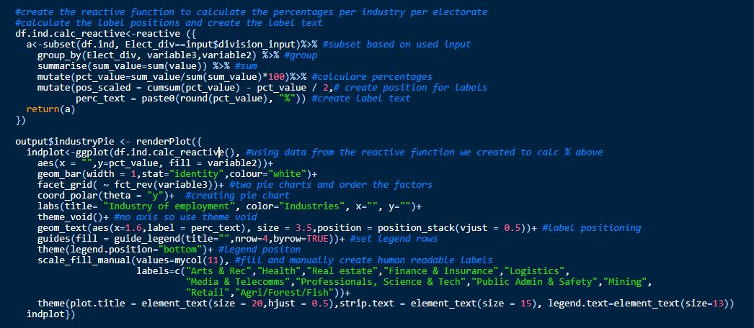
things I’VE SPENT WAY TOO MUCH TIME ON PART 1
Labelling a pie chart which changes based on user input – therefore the centre of each of the 20+ slices can change up to 30x

Slide 8
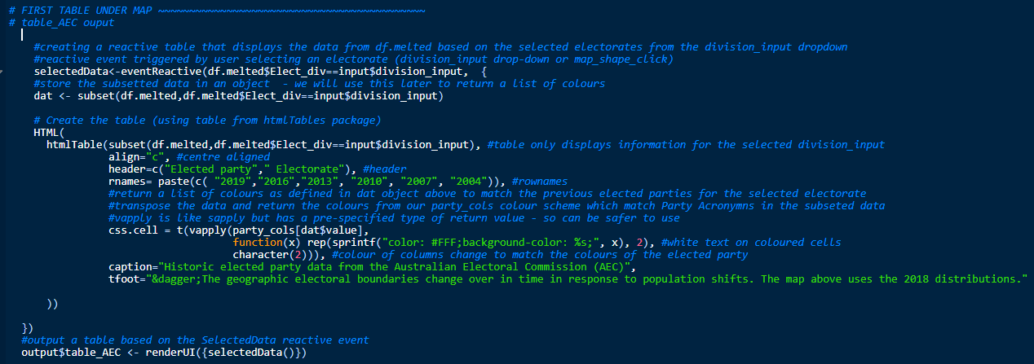
things I’VE SPENT WAY TOO MUCH TIME ON PART 2
Colouring individual rows of a table based on user input
Notes:
Define the political party colours based on the party acronyms in the data
When an electorate is selected from the division_input drop-down menu we are going to create a subset of the data based on that selection called dat
Create the table output using the HTML Table package which will only display rows for past elected parties dating back to 2004 for the selected electorate
Format the table
Using the css.cell functionality within the HTML Table package we are going use vapply which is like sapply but a bit more specific so it can be safer to use to return a list of colours (as defined in our dat object above) that match the past elected parties for the electorate selected by the user.
Add a footnote and caption
All of this is stored in as a reactive event triggered by a user selecting an electorate from the drop down menu or by clicking on the map and this is all stored in an object called SelectedData

Slide 9
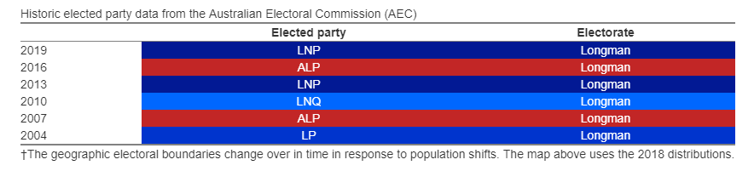
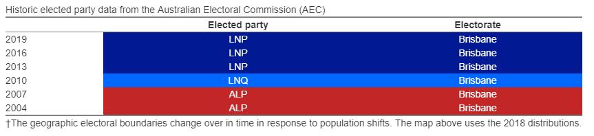

Slide 10

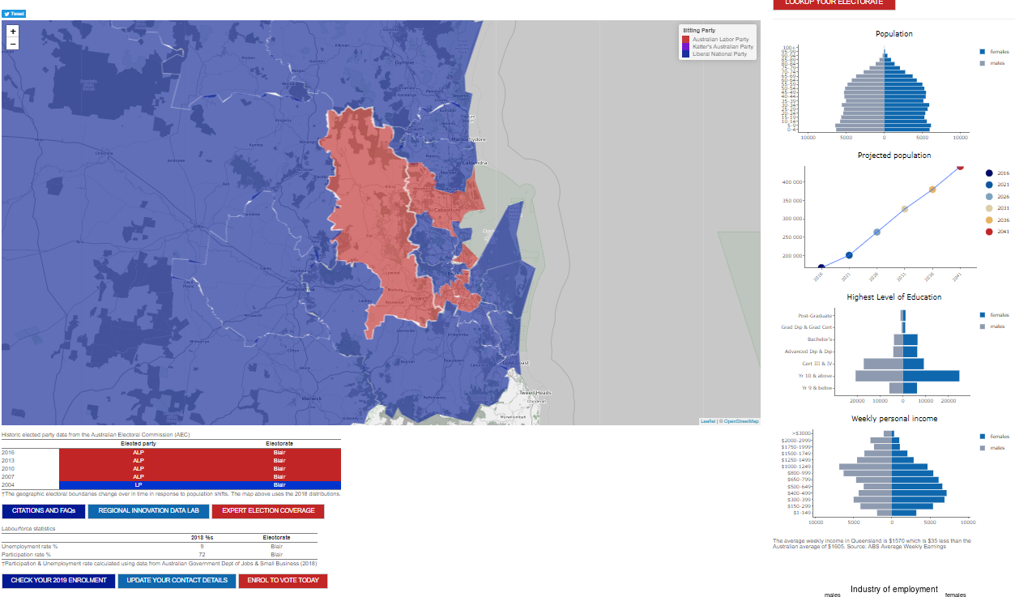
2019 Election
Policy Innovation Hub
Project Brief: “Easy to digest, interactive and engaging way for policy and political experts to facilitate data driven conversations.”
SA2 (2016) level open data (on average 10K ppl per SA2 but range from 3-25K)
Permission to use 2018 electoral boundaries
R, RShiny, shinyapps.io
Code: gitlab.com/r.chappell/2019_ElectionApp_RIDL
https://regionalinnovationdatalab.shinyapps.io/Dashboard/
Notes:
Data – open sa2 level – aggregated to the CED 2018 level – permission to use 2018 boundaries
Australian Bureau of Statistics (ABS), 2016 and 2018
Australian Electoral Commission, 2018
Australian Government Department of Jobs and Small Business, 2018
Queensland Department of Social Services, 2018
Queensland Government, 2018
Lilley – show no change Labour for the last 15 years and the margin for the seat is 5.8%
Longman – there has been a lot of change and the current margin for the liberals is only 0.8% so watch this space right?

Slide 11
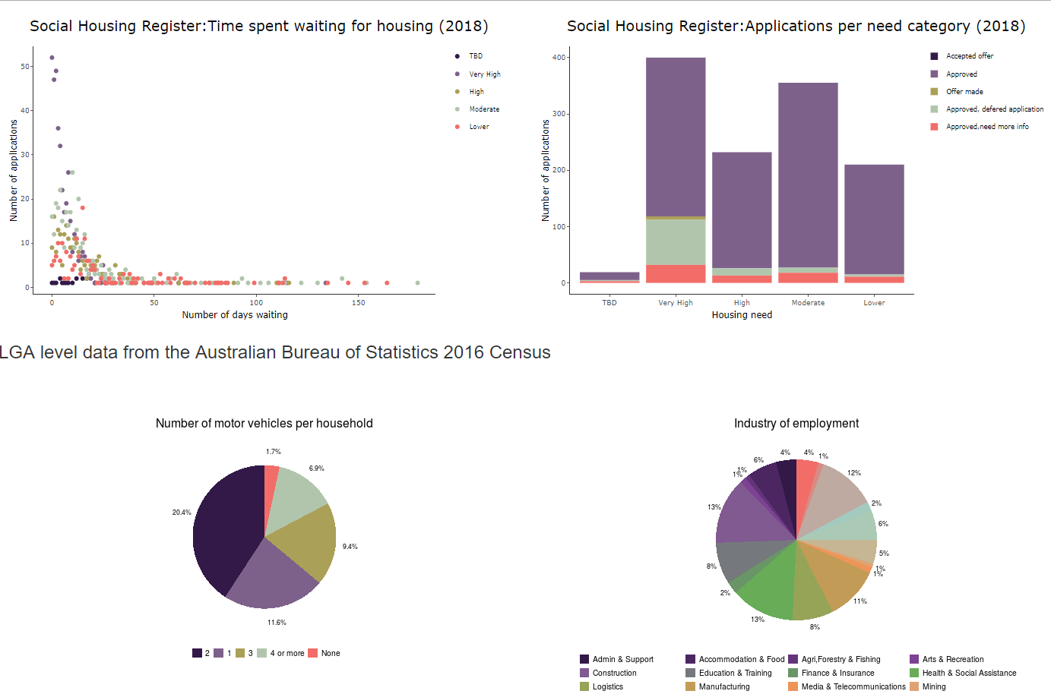
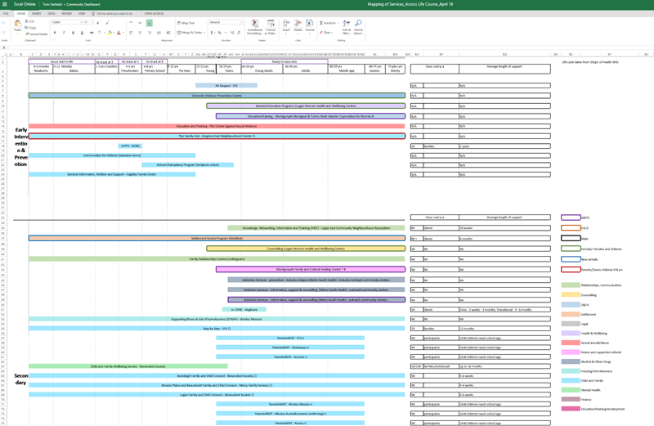
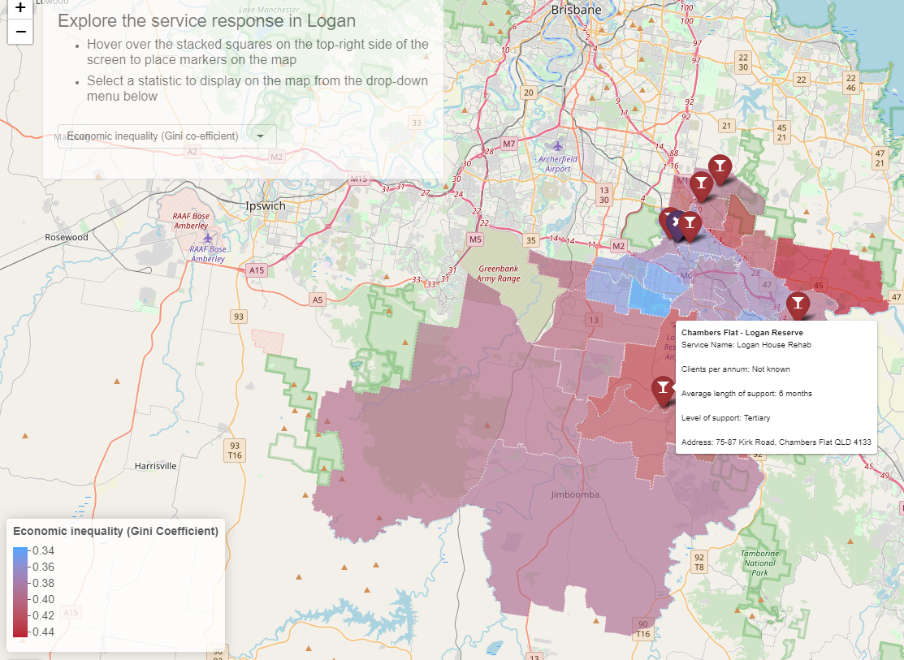
Logan TOGETHER: SERVICE RESPONSE
Logan Together – Key Partner
Manually collected, open and sensitive data (SA2 and LGA)
R, Rshiny, shinyapps.io
https://regionalinnovationdatalab.shinyapps.io/Logan/
Notes:
Logan is one of the fastest growing areas in Australia, with an extra 200,000 people coming to live in the city over the next 20 years.
Logan is also a very young city with around 50% of residents aged 30 or younger. Within 30 minutes drive of Logan Central live the largest number of Aboriginal and Torres Strait Islander people under 25 in Australia. The challenges faced by the Logan community are growing and complex and as a result, community leaders, Government officials and researchers need a set of tools to be able to quickly understand how their policies, service responses and community support networks are tracking, and this is what I’ve built.
Logan Together is one of RIDL’s key partners and they partner with over 150 community and government organisations across the Logan area
Spreadsheet -> interactive dashboard a much more user friendly and engaging way to facilitate discussions around the service response in the Logan area.

Slide 12
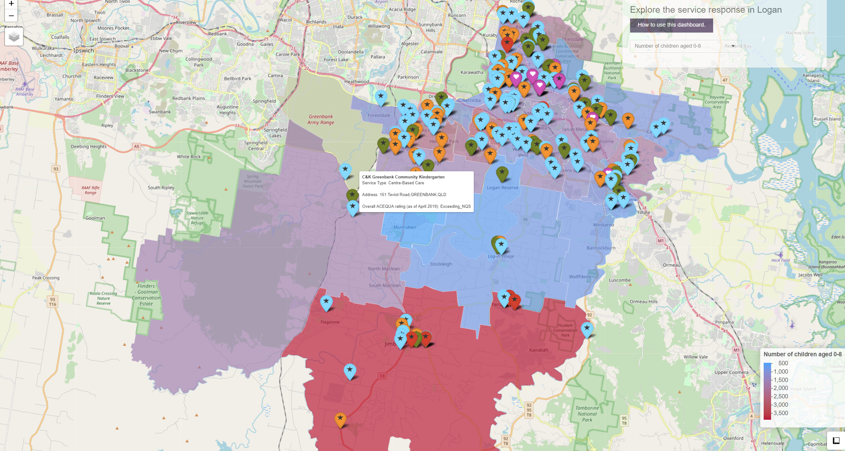
Notes:
Australian Curriculum Evaluation Quality Authority (ACEQUA)
National Quality Standards (NQS)

Slide 13
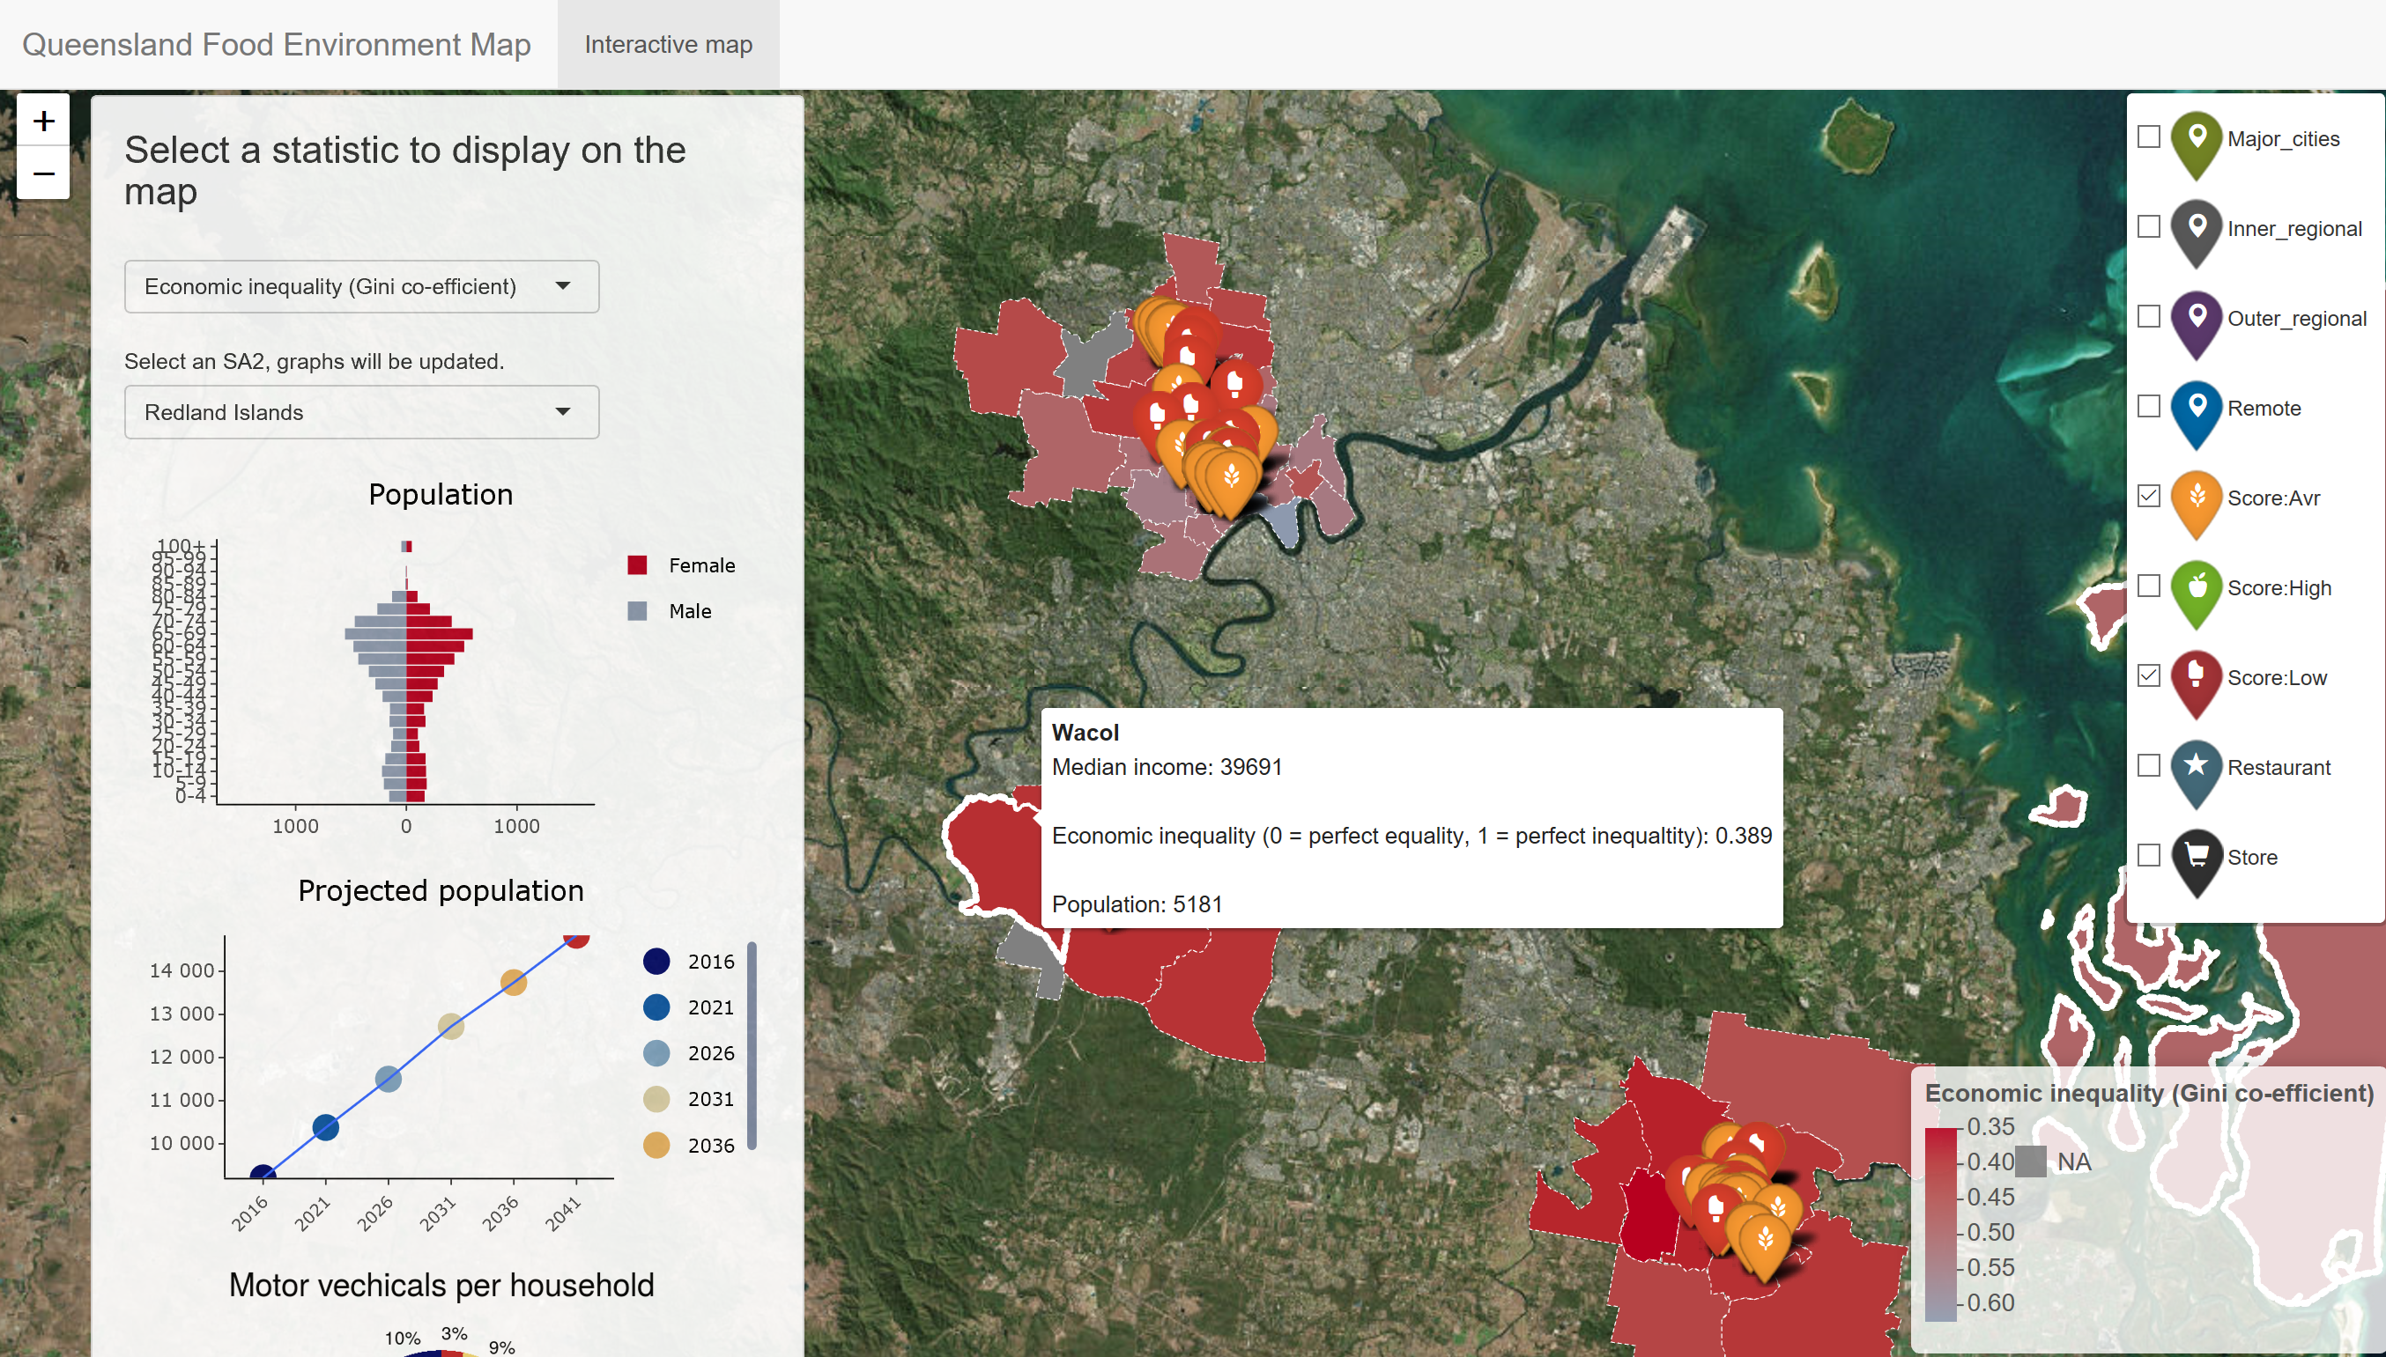
Food environment : Research Translation
NEMS: Nutrition Environment Measures Study
Regional, Metro, Outer Regional and Inner Regional
Data collected by Griffith PHD student
Still in development
Notes:
Nutrition environments are the places in a community where people buy or eat food.
Assessments of nutrition environments at restaurants focus on eight types of food indicators:
healthy main dish choices (low-fat, low-calorie, healthy main dish options)
availability of fruits and vegetables without added sauce
whole grain bread and baked chips
Beverages
children's menus
signage and promotions
facilitators and barriers to healthy eating
pricing, and accessibility.

Slide 14
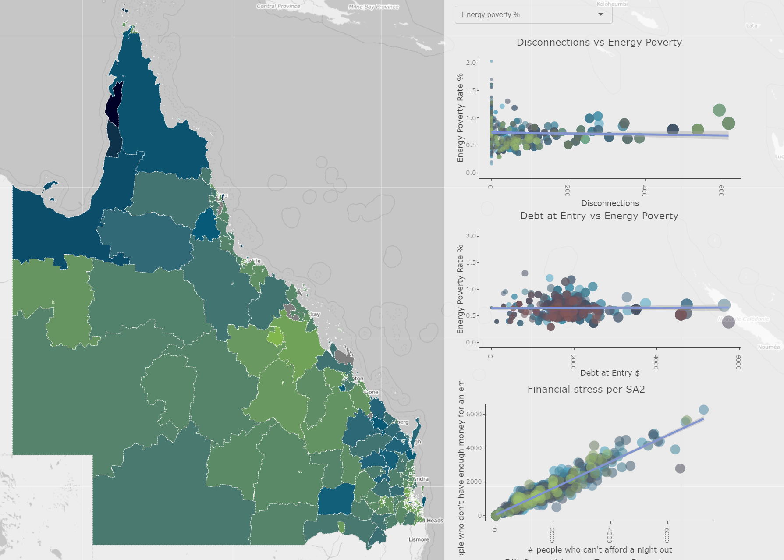
UNDERSTANDING ENERGY POVERTY
Working with industry
Sensitive data at the Suburb and SA2 level
Still in development

Slide 15
THANK YOU!
LINKS:
Great shiny tutorials and ideas: https://deanattali.com/
Shiny inspo: https://shiny.rstudio.com/gallery/
Service Response: https://regionalinnovationdatalab.shinyapps.io/Logan/
Election Dashboard: https://regionalinnovationdatalab.shinyapps.io/Dashboard/
RIDL: https://www.griffith.edu.au/griffith-business-school/policy-innovation-hub/regional-innovation-data-lab
My Code: https://gitlab.com/r.chappell
@rhetta_chappell
Notes:
I hope you got to know a little bit about what I do and how the Regional Innovation Data Lab plans to help communities unlock the hidden potential in their data.

